Slide 1
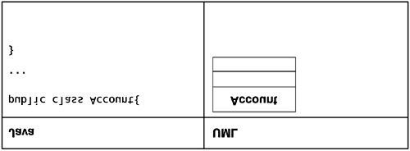
A class

Slide 2
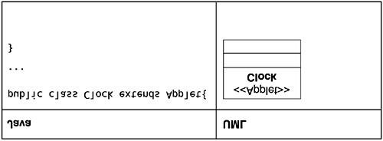
A Stereotyped Class Servlet, Applet, Interfaces (JPA, Spring) <<Spring>>

Slide 3
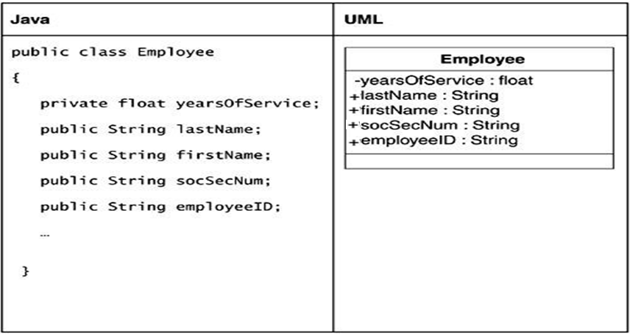
Class with attributes
Private : -
Public : +
Default/ internal : #
Protected : ~

Slide 4
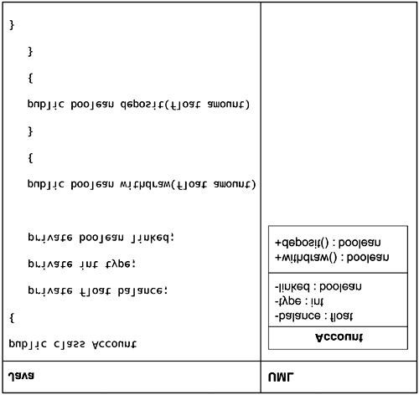
A class with attributes and operations
Variable : datatype
Int a
a:int
Int add(int a, int b):
add(a:int,b:int):int

Slide 5
Sterotype
Class A implements In{
Method1()
Method2()
}
In {
Method1();
}

Slide 6
Lolipop
Class A implements In{
Method1(){ }
Method2(){ }
Attribute list;
}
In {
Method1();
Method2();
}
A
In

Slide 7
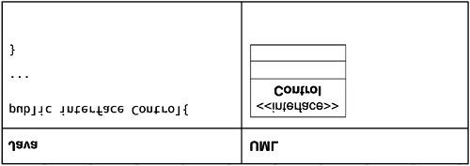
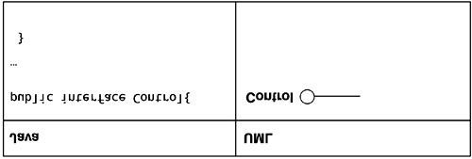
An interface : as a stereotype and Lolipop model

Slide 8
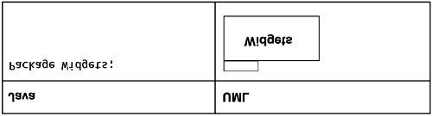
A Package

Slide 9
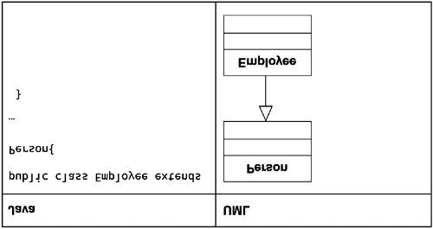
Representing the inheritance relationship

Slide 10
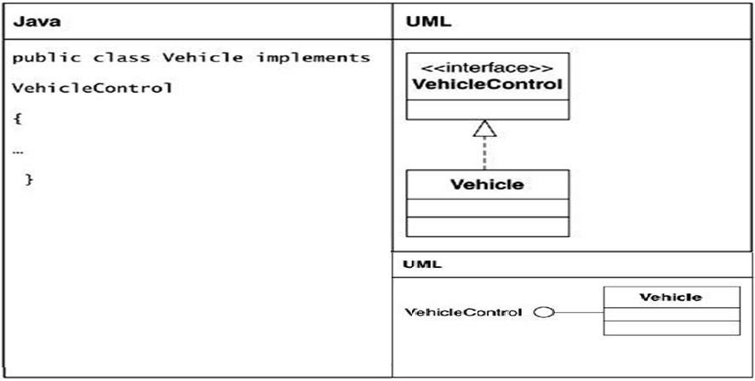
Realization

Slide 11
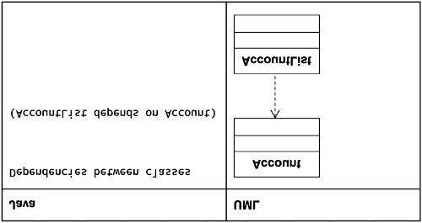
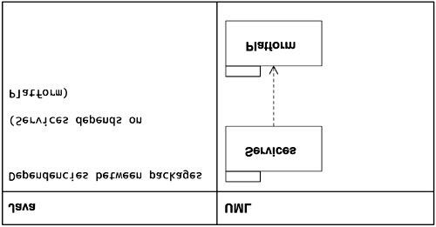
Dependency List<Account> AccountList =…

Slide 12
Class Account{
..
}
..
List<Account> AcList=new…
AcList : object of type List; but is dependent on Account Object.
AcList.add(“nmm”);
AcList.add(new Account());

Slide 13
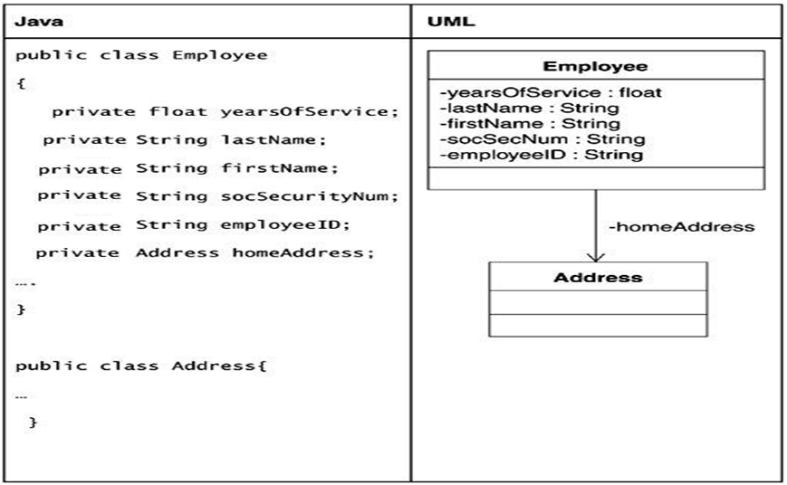
Unidirectional association

Slide 14
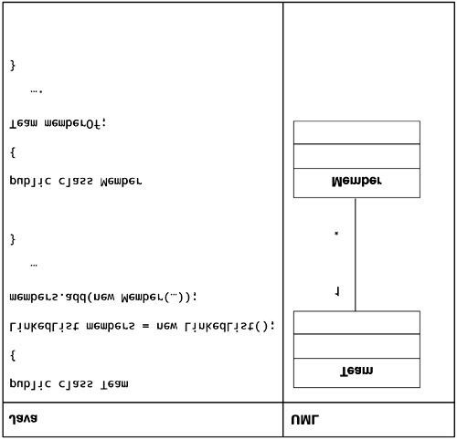
Bidirectional association
0..m, m/n/*, 1, 1..m, 0..1, 0, 1, ……

Slide 15
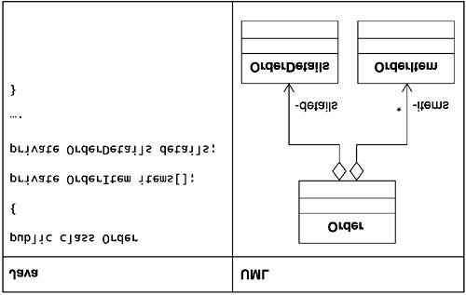
Aggregation

Slide 16
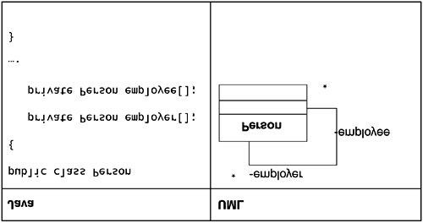
Reflexive association

Slide 17
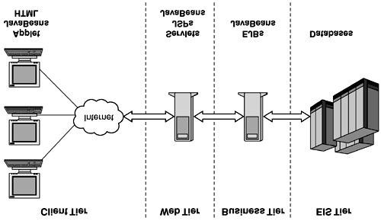
The J2EE big picture

